Slide 1
Суперкомпьютер Watson - новая система координат в медицине.
Шклюдов Павел, Лидер направления государственный сектор подразделения Разумная Планета в Центральной и Восточной Европе
Follow us @IBMWatson

Slide 2
IBM Watson - сочетание революционных технологий
2
Генерирование и оценка гипотез основанных на фактах
1
Восприятие естественного языка и общения
3
Обучение с учителем на основе выбора и оценок экспертов
…построен на массивно параллельной архитектуре адаптированной для IBM POWER7
Notes:
2
Main Point: At the core of what makes Watson different are three powerful technologies - natural language, hypothesis generation, and evidence based learning. But Watson is more than the sum of its individual parts. Watson is about bringing these capabilities together in a way that’s never been done before resulting in a fundamental change in the way businesses look at quickly solving problems
Solutions that learn with each iteration
Capable of navigating human communication
Dynamically evaluating hypothesis to questions asked
Responses optimized based on relevant data
Ingesting and analyzing Big Data
Discovering new patterns and insights in seconds
Further speaking points:. Looking at these one by one, understanding natural language and the way we speak breaks down the communication barrier that has stood in the way between people and their machines for so long. Hypothesis generation bypasses the historic deterministic way that computers function and recognizes that there are various probabilities of various outcomes rather than a single definitive ‘right’ response. And adaptation and learning helps Watson continuously improve in the same way that humans learn….it keeps track of which of its selections were selected by users and which responses got positive feedback thus improving future response generation
Additional information: The result is a machine that functions along side of us as an assistant rather than something we wrestle with to get an adequate outcome
2

Slide 3
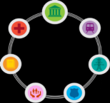
История развития IBM Watson
IBM Research Project (2006 – )
Jeopardy! Grand Challenge (Feb 2011)
Watson for Healthcare (Aug 2011 –)
Watson for Financial Services (Mar 2012 – )
Watson Industry Solutions (2012 – )
Cross-industry Applications
Expansion
Commercialization
Demonstration
R&D
Notes:
3
01/18/12
3
Main point: Bringing about a transformation in what was as a society expect of technology does not happen overnight. Watson has been an iterative growth process that continues this day and into the future.
Further speaking points: Watson was a research project in IBM starting in 2006. The effort was led by a team of 15 IBM researchers working in collaboration with a pool of top universities as a “Deep QA” project. Jeopardy! was selected as the ultimate test of the machine’s capabilities because it relied on many human cognitive abilities traditionally seen as out of scope for machines such as ability to discern double meanings of words, puns, rhymes, and inferred hints. It also demanded extremely rapid responses and the ability to process vast amounts of information to make connections typically requiring a lifetime of immersion in pop culture and participation in the general human experience.
With Jeopardy! in the past, IBM and Wellpoint, one of the US’s largest health insurers, announced a partnership to pilot Watson for use among member hospitals and the insurance organization itself with a goal of improving patient outcomes and health treatments. As a byproduct, it is also expected to improve the productivity of healthcare professionals.
From Healthcare, Watson is expected to branch into other industries that rely on analytic solutions to managing unstructured data.
Additional information: Financial services organizations and call center operations are seen as high potential areas.
IOD2011
4/9/12
GS302_ManojSaxena_v7
3

Slide 4
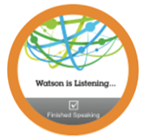
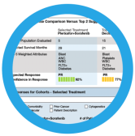
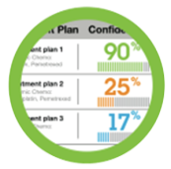
Watson предоставляет три класса сервисов
Ответы на вопросы
Большие объемы данных и фактов
Уточняющие вопросы
Запросы на естественном языке
Генерация гипотез
Исследование
Найти подтверждающие факты для заданных гипотез
Определить нехватку фактов для оценки гипотезы
Уточнить гипотезу
Принятие решений
Использование и анализ отраслевых баз знаний и моделей принятия решений
Генерирует решения на основе подтверждающих фактов
Обучение и обратная связь
Notes:
Main point: Watson use cases can be broadly broken into three classes: Ask, Discover, and Decide. Users can ASK Watson direct questions in natural language the same way they ask friends or colleagues questions. This is in contrast to reducing an inquiry to a set of keywords and receiving a set of links to sources where their answers may (or may not) lie. People who saw Watson’s victory on the quiz show Jeopardy! will be familiar with this simplest use case. Think of this as next generation chat. Second, users can DISCOVER new insights with Watson. Examples of this could be use of Watson as a research assistant such as a biotech investigator looking for the best way to treat a disease in a specific cohort of patients. Finally, users might use Watson to help them DECIDE on the best course of action. This would be for situations where users are looking for confidence-based recommendations for their next action when they have many options to chose from such as what course of treatment to prescribe to a patient or what investment choice to make.

Slide 5
Здравоохранение сталкивается со сложными информационными задачами
1 из 5
Диагнозов признаётся не правильными или не полными
1.5 миллиона ошибок в выписанных рецептов в год в США
44,000 -98,000
Американцев умирают от врачебных ошибок, которые можно было предотвратить
Объем медицинской информации удваивается за 5 лет, большая часть из которой является не структурированной
81% врачей тратят не более 5 часов в месяц на чтение медицинской литературы
“Medicine has become too complex. Only about 20% of the knowledge clinicians use today is evidence-base.” Steven Shapiro, Chief Medical & Scientific Officer, UPMC
Notes:
Main point: Healthcare is a great example of how these challenges come to life. Physicians can not keep up with the explosive growth of medical information which is doubling every five years. Reading journals is the primary way new medical information is delivered yet the vast majority of physicians don’t spend anywhere near enough time to keep up with it.. Meanwhile, diagnosis, treatments, and preventable deaths leave huge room for improvement
Further speaking points: Imagine you’re in a hospital waiting room with 9 others waiting to seen. Chances are, two of you are going to be misdiagnosed. Preventable medical errors kill 44K-98K Americans every year. That’s enough to fill a big college football stadium. Imagine what the total would be world wide. As Steven Shapiro, Chief medical and scientific officer at UPMC says “Medicine has become too complex (and only) about 20% of the knowledge clinicians use today is evidence based”. We just spoke about the gap between today’s IT needs and traditional IT. Surely, a new approach to IT can help address some of the healthcare difficulties described here.
Additional information: statistics on right.
5

Slide 6
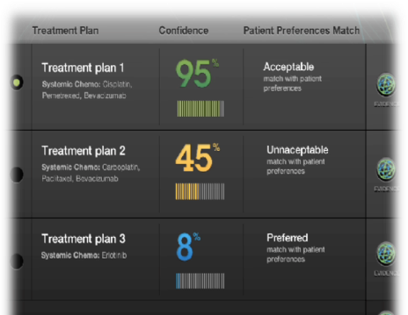
Пример: IBM Oncology Diagnosis and Treatment Advisor
Пример того, как Watson может помочь онкологу:
Синтез разрозненных данных – мед карта, анамнез, анализы и исследования, патологии и т.д.
Идентификация отсутствующих данных и требуемые исследования
Предложение персонализированных схем лечения с учетом ранжирования и подтверждающих
Notes:
Discuss main points of the demo.
6

Slide 8
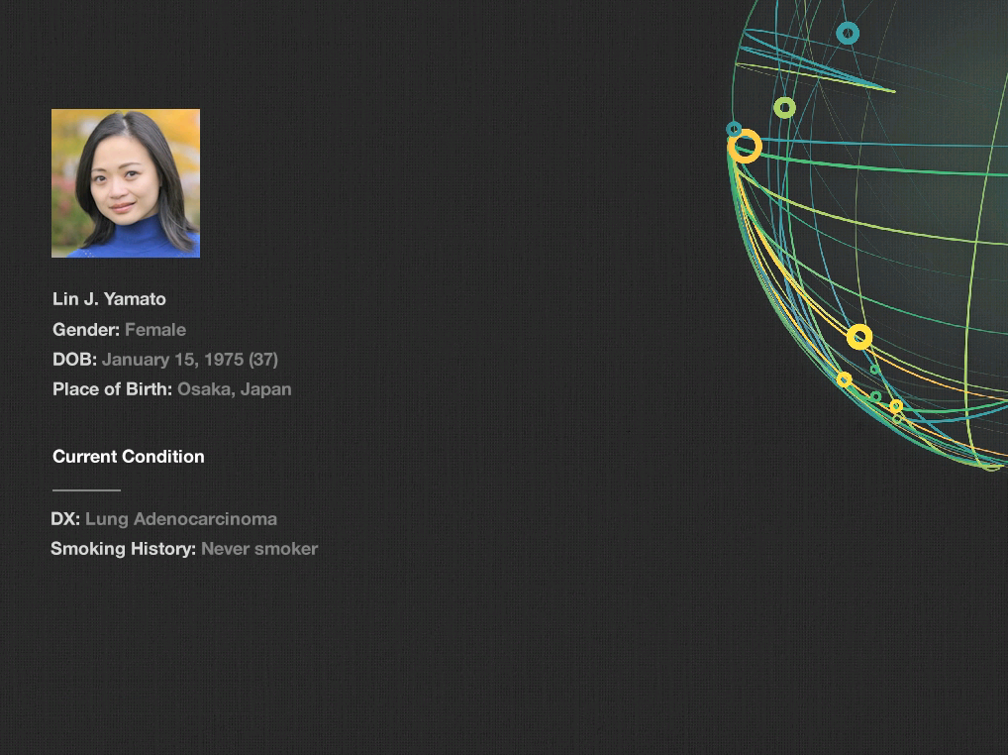
Notes:
Let’s consider a hypothetical patient. She’s 37 years old and has never been a smoker. She meets with her primary care physician because of a persistent dry cough and shortness of breath. After a series of tests including a chest X-ray, MRI, and biopsy, her doctor suspects that she has cancer and forwards her electronic medical record to an oncologist.

Slide 9
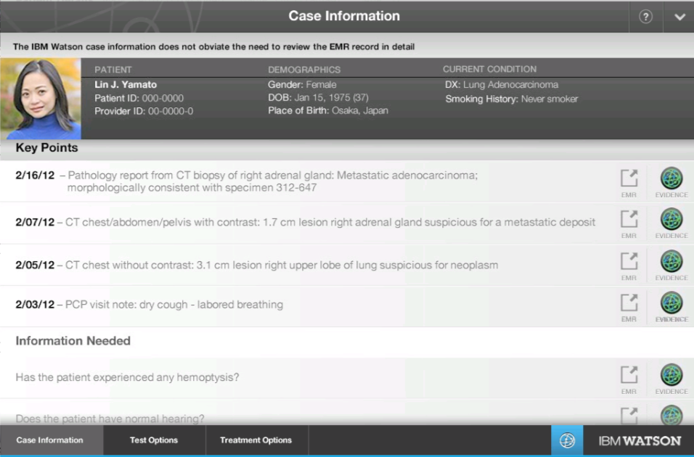
Notes:
The Watson Oncology Advisor invokes the Watson advisor to help prepare to meet with the patient. It compares her electronic medical record against millions of pieces of information from the medical literature including text books, journal articles, best practices, and guidelines. The Watson advisor presents the oncologist three panels – Case Information, Test Options and Treatment Options – based on it’s analysis of the information available about the patient’s case.
On the Case Information tab the oncologist can get a quick snapshot of the patient information and key points from all the various clinical notes and test reports that the oncologist should pay attention to. The Advisor also allows quick navigation to the section in the EMR where the key fact resides.
Not only does the Watson Advisor identify the key facts from the available information, but it also identifies missing information that the oncologist should gather from the patient or via tests. For example, in this case the Advisor has identified two pieces of information that the oncologist should check with the patient during her consultation: 1) whether she has coughed up blood (hemoptysis) and 2) if she is having any problems with her hearing.

Slide 10
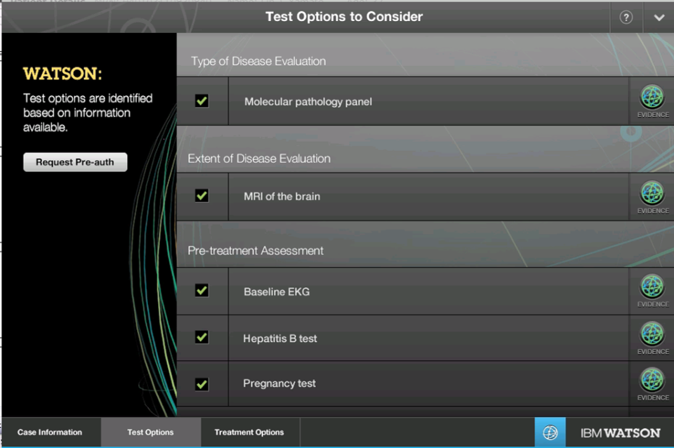
Notes:
On the Test Options tab, the Watson Advisor has identified tests that the Oncologist should consider to gather additional clinical information, for example, MRI of the brain to check if the cancer has spread to the brain. Not only does the Advisor recommend the test options, it also provides the rationale for recommending the test. For example, if the oncologist were to press on the evidence button for the Molecular pathology panel test the oncologist will see the reason for suggestion for this test, along with the references – NCCN guidelines, MSK best practice, article from the Journal of Clinical Oncology - that support the rationale. The oncologist can review the details behind the reference down to the level of the specific text within the reference that was used to support the reason for suggesting the test.

Slide 11
Notes:
As in all other areas of the Advisor, the oncologist can see the references that contain the evidence that support the treatment plan suggestions. Broad level evidence is presented on the left and specific references are on the right. The oncologist can push ‘view’ to see any specific reference in more detail.

Slide 12
Notes:
Once the tests are complete and results are added to the existing information that has already been gathered, the Watson Advisor has identified treatment options for the oncologist to consider along with the corresponding confidence levels. Watson has also indicated how each of the treatment options align with the patient’s preference for limiting hair loss, if possible.
Since the treatment plan was completely evidence based, the patient’s insurance carrier instantly authorizes the treatment and the patient’s treatment can begin immediately.
The case is added to the Watson Advisor’s records and is now part of its training data which is used as part of the feedback loops that allow Watson to improve with every interaction through machine learning.
This hypothetical demonstration is an example of how IBM is putting Watson to work in healthcare as well as applying it’s groundbreaking capabilities to data-intensive scenarios across other industries.
**Note*** There was a fairly recent journal article that second guesses the treatment #1 displayed in this demo. Below is the text of a note from Dr. Marjorie Zauderer at MSK.
This study compared carboplatin, taxol, and bevacizumab with bevacizumab maintenance to carboplatin, pemetrexed, and bevacizumab with pemetrexed and bevacizumab maintenance as first-line therapy in patients with advanced non-squamous lung cancer.
The regimens were found to be equivalent in terms of overall survival.
Either regimen is acceptable and this decision should be deferred to the discretion of the treating physician who would take into account patient-specific concerns and preferences.
At MSKCC, cisplatin, pemetrexed, and bevacizumab with pemetrexed and bevacizuamb maintenance remains the preferred treatment for these patients. Use of MSK's recommended regimen was not addressed in this trial. It is also our practice to continue all drugs until progression if they prove beneficial, as recommended in the NCCN guidelines.
First, cisplatin is more effective than carboplatin but cisplatin was not part of either regimen studies.
Second, the pemetrexed based regimen has less side effects and enhances the ability to deliver cisplatin. For those situations where cisplatin is not safe, carboplatin is used in its place.
Because survival is equivalent, we continue to recommend the pemetrexed based regimen and continuation of both pemetrexed and bevacizumab to progression because of the superior outcimes for patients who continue on therapy.

